Slide 1

Customer Subscription-Based Digital Product: A Machine Learning to Predict Churn
by Tiara Fitriyani

Slide 2


About Dataset
This dataset contains valuable information about a subscription-based digital product that offers financial advisory services, encompassing a wide range of features such as newsletters, webinars, and investment recommendations.
The product caters to various preferences, providing both annual and monthly subscription options. To enhance customer satisfaction, the platform offers daytime support, enabling customers to connect with a dedicated care team for product-related inquiries, as well as assistance with signup and cancellation processes.

Slide 3
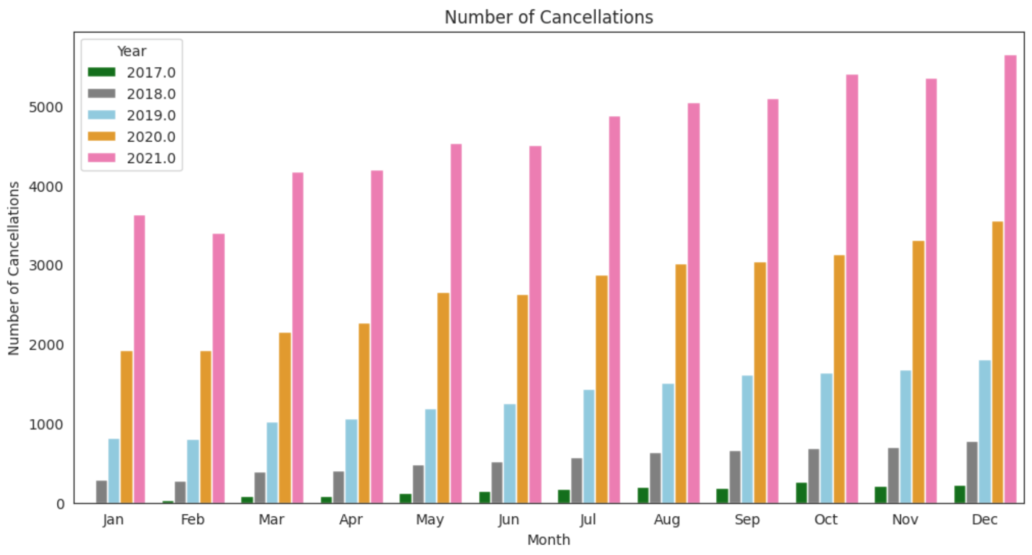
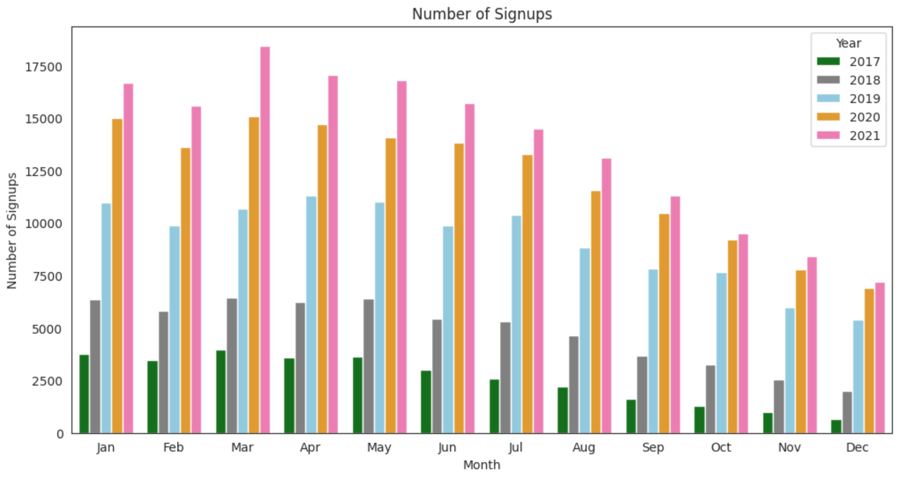
Business Problem
The number of signups appears to be most significant during the first to third quarters in each year, and despite a decrease in signups towards the end of the year, the overall trend shows a consistent increase in the number of signups from year to year. This is quite promising, isn't it?
The number of cancellations has also increased, and in fact, they consistently show an upward trend every month and every year!
Let's take a look at the percentage comparison.

Slide 4

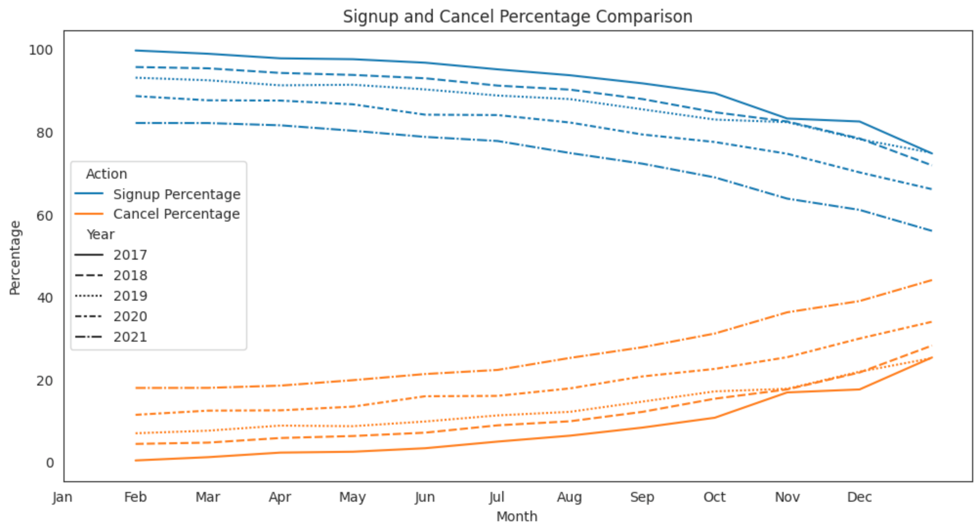
As the years progress, the percentage of signups continues to decline, while the percentage of churn keeps rising. In fact, in the year 2021, both percentages are nearly equal! This is a significant concern. Hence, the company needs to predict customer churn behavior.

Slide 5

Objectives
Analysis
Understand more about customer behavior that occur on the platform.
Recommended Action
Product enhancement and maximizing case services based on exploratory data analysis results.
Prediction
To predict customer churn.

Slide 6

Customer Case
Customer Info
Tabel customer case berisikan data customer dan case yang di alami. Terdapat 330.512 data dan 5 kolom (case_id, date_time, customer_id, channel, reason)
Tabel customer info berisikan data informasi customer. Terdapat 508.932 data dan 3 kolom (customer_id, age, gender).
Data Understanding
This dataset contains 4 tables; Customer Case, Customer Info, Customer Product and Product Info.
Customer Product
Product Info
Tabel customer product berisi data customer dan product yang digunakan. Terdapat 508.932 data dan 4 kolom (customer_id, product, signup_date_time, cancel_date_time).
Tabel product info berisi data informasi mengenai product yang ditawarkan perusahaan. Terdapat 2 data dan 4 kolom (product_id, name, price, billing_cycle).

Slide 7
Feature Integration by Merge Data All tables are merged using the 'merge' method, resulting in a comprehensive single DataFrame with a total of 508,932 rows and 13 columns with no duplicated data.
Missing Value
After merged, all of feature has no missing value except ‘cancel_date_time’ because not all of the customers canceled their subscription.
Data Preprocessing
Exploratory Data Analysis.
& Visualization
Univariate, bivariate and multivariate analysis.
Feature Engineering
Converting categorical data into numeric using label encoding method.

Slide 8

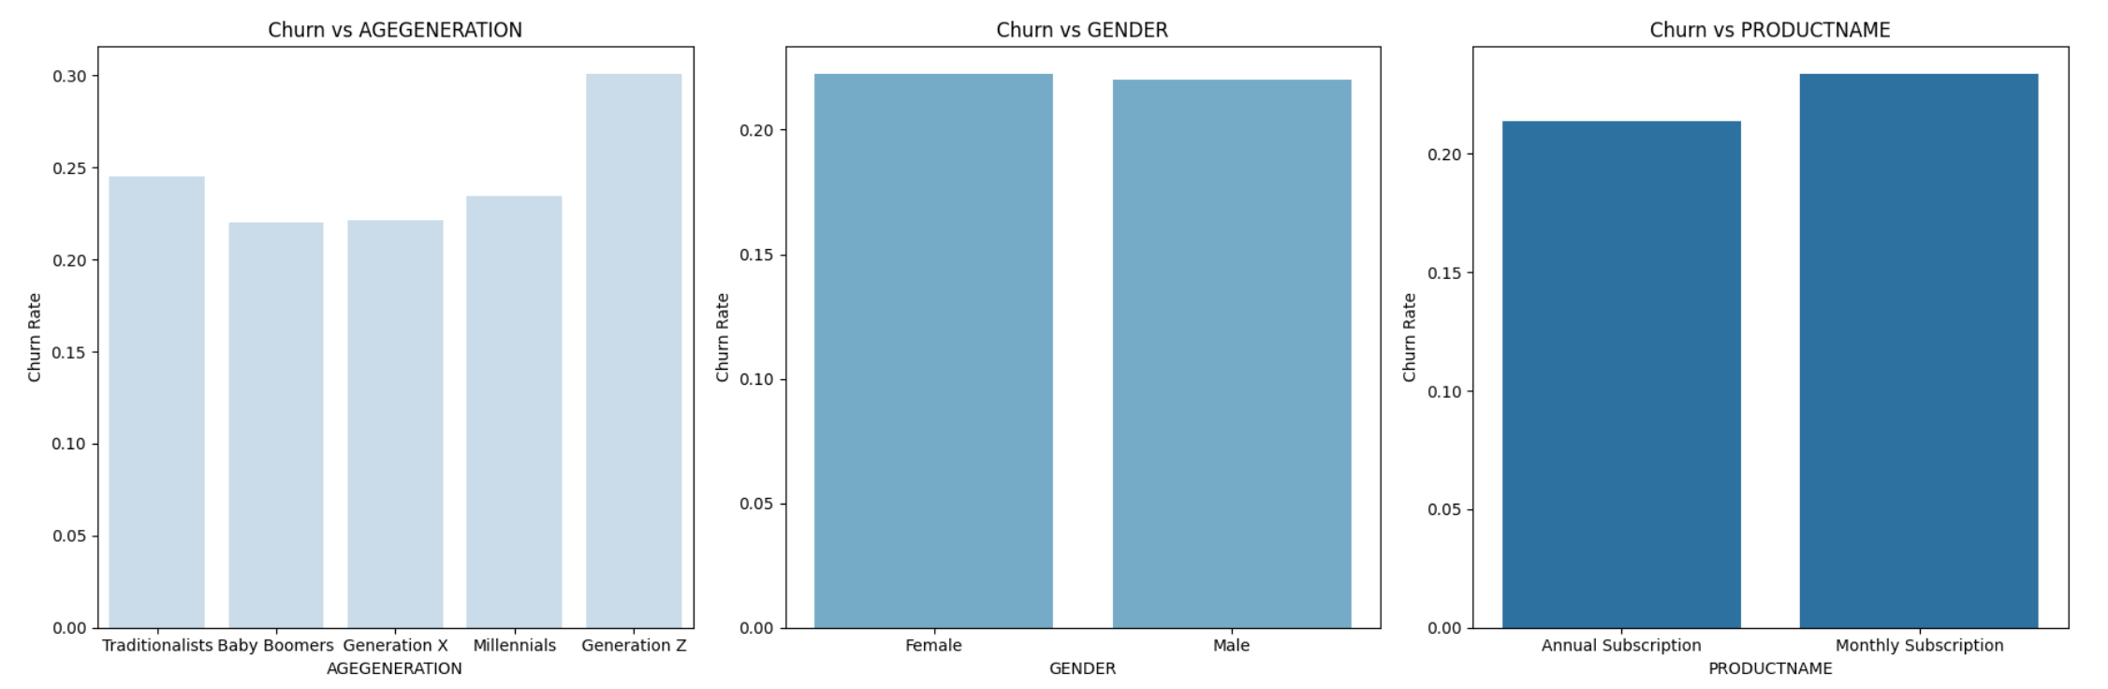
Influence of Age Generation, Gender, and Products on Churn Behavior
The churn rate appears to be higher among customers belonging to Generation Z, female, and monthly subscription product.
Let’s check them out!

Slide 9
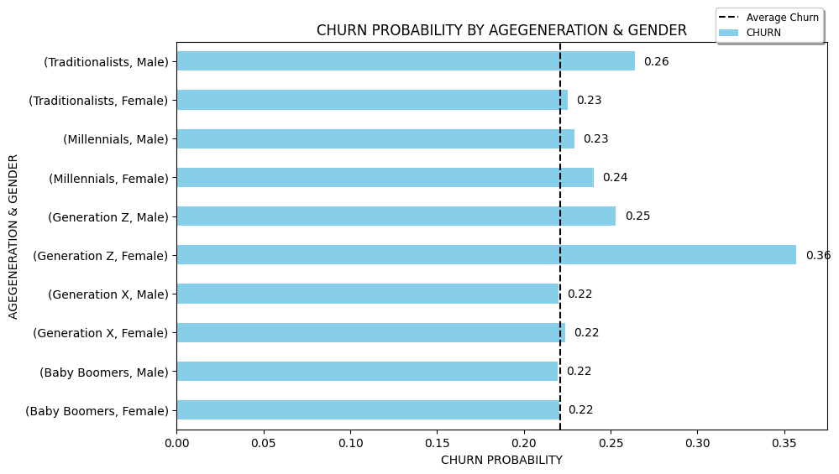
Churn Probability by Age Generation and Gender
Fyi:
Baby boomers = 57 – 75 yo
Traditionalist = 41 – 56 yo
Millennials = 25 – 40 yo
Gen Z = 9 – 24 yo
Alpha = 10 - now
Action
Develop targeted marketing campaigns and offers tailored to the preferences of these segments.
Both male and female Gen Z customers exhibit a relatively high likelihood of churn, particularly among females. Additionally, Traditionalist and Millennial generations also experience churn probabilities above the overall average.

Slide 10
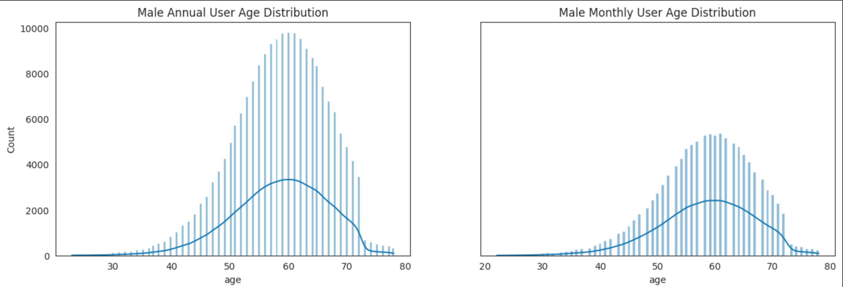
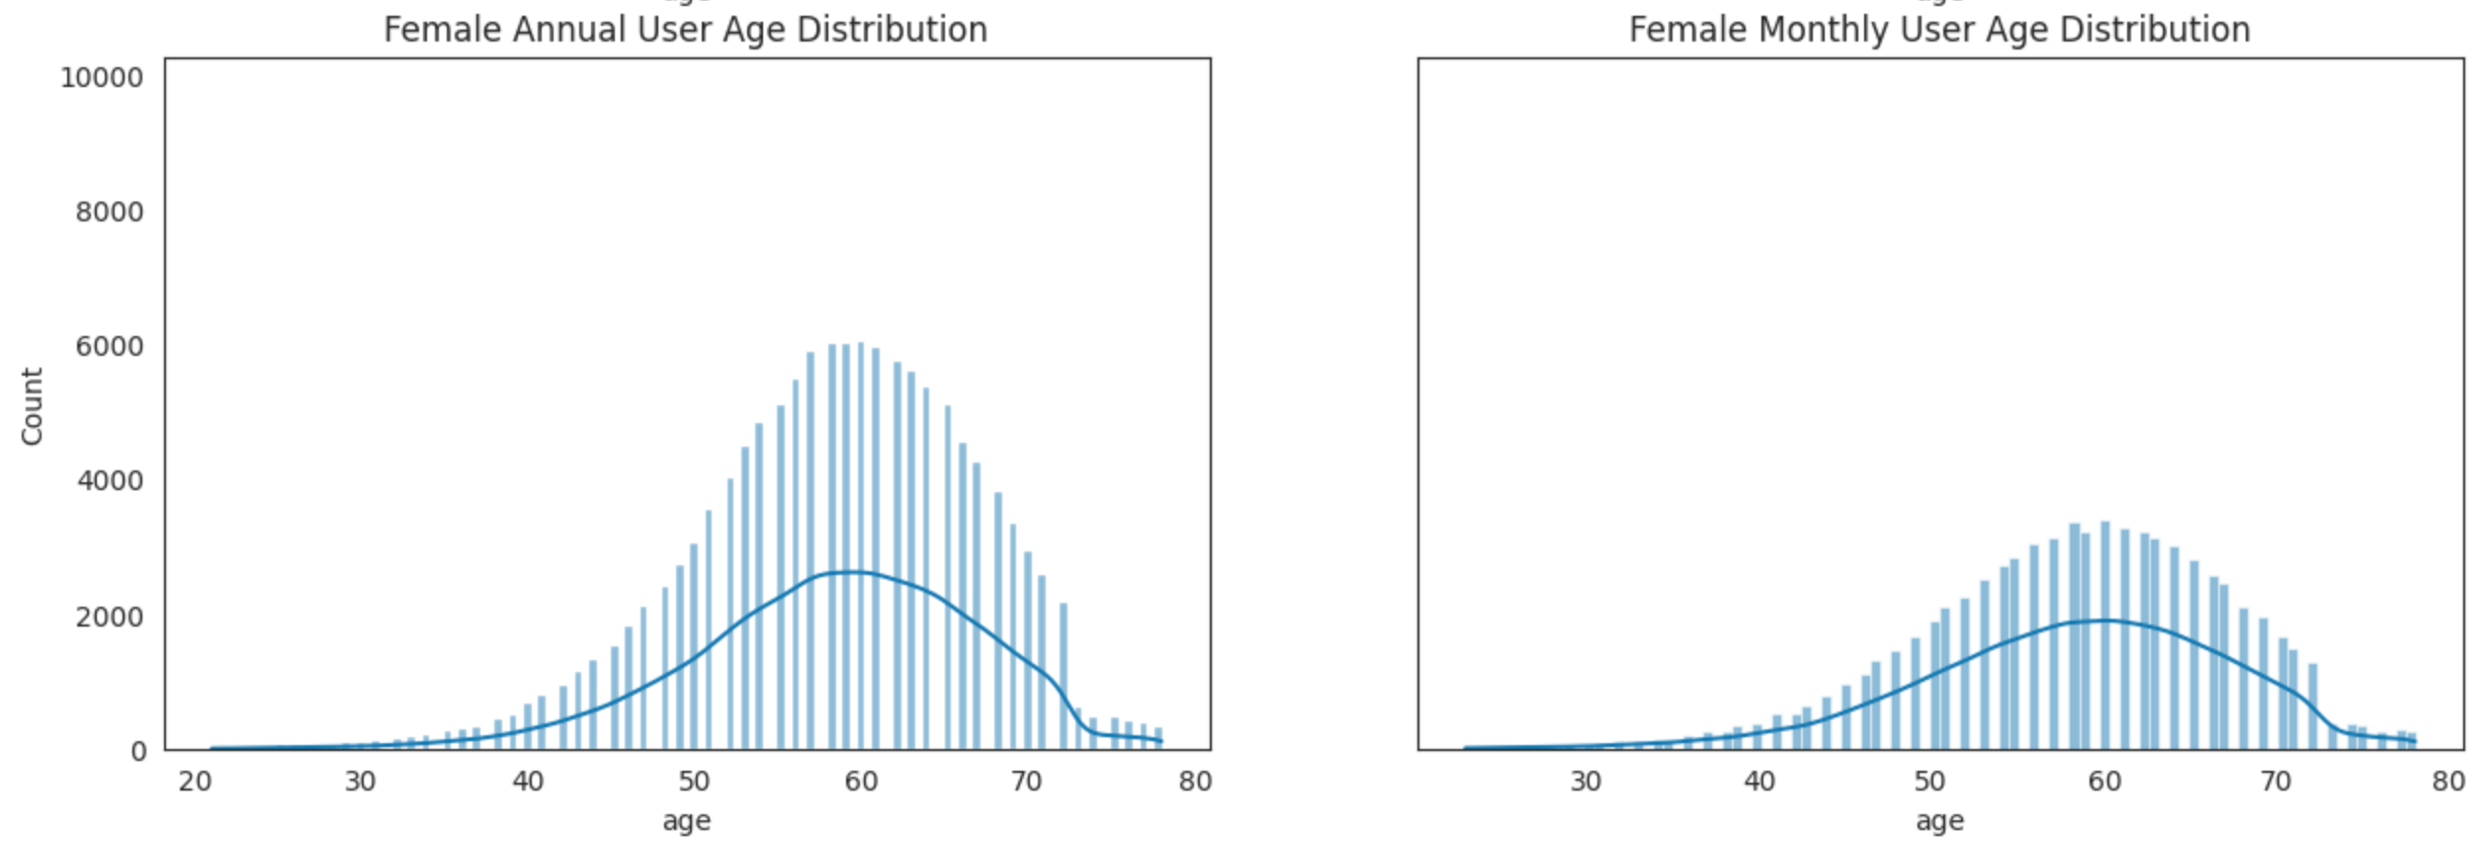
Product Market Share
It appears that the company's offerings are more appealing to customers aged 50-70.
The majority of customers are male and the most frequently used product is the annual subscription.

Slide 11
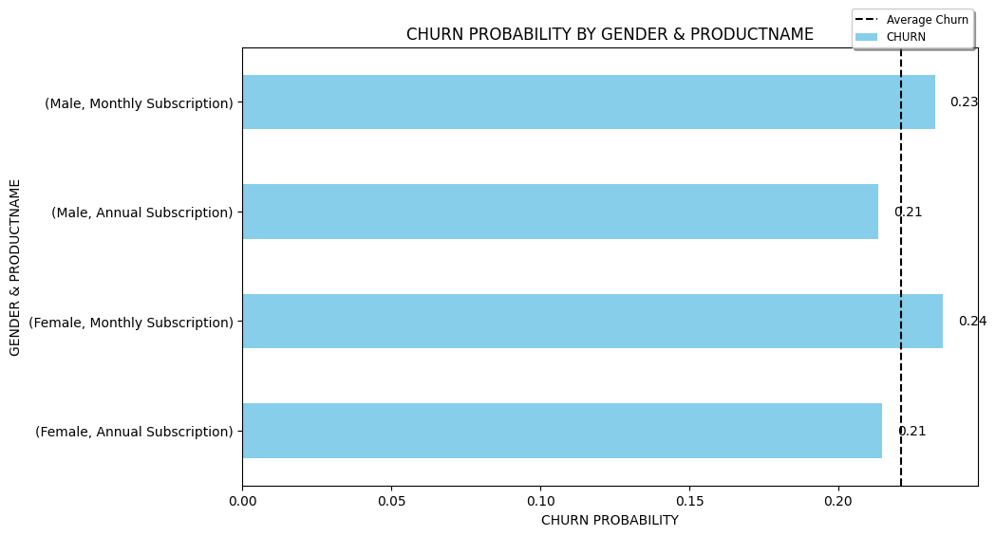


Churn Probability by Gender and Products
Action
Intensify marketing efforts and tailor offers specifically for this age group. However, consider expanding to a broader market and appealing to other age groups.
Both male and female customers with a monthly subscription product have a higher churn rates than the overall average churn percentage.

Slide 12
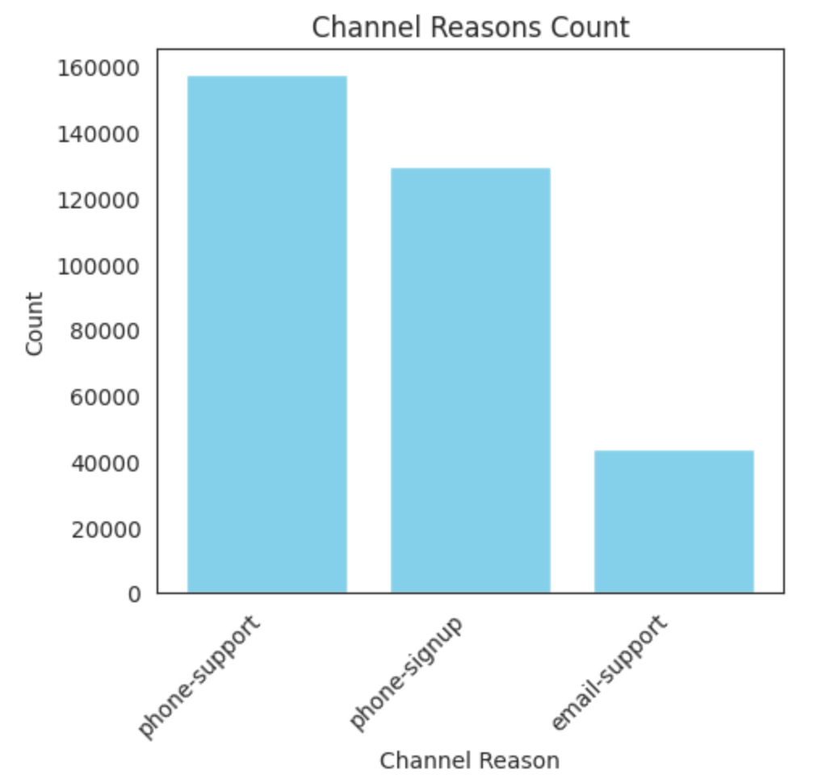
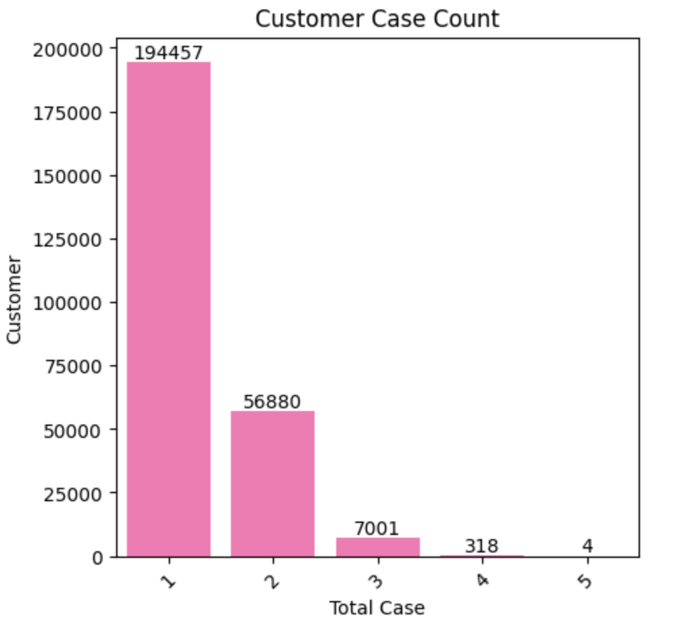
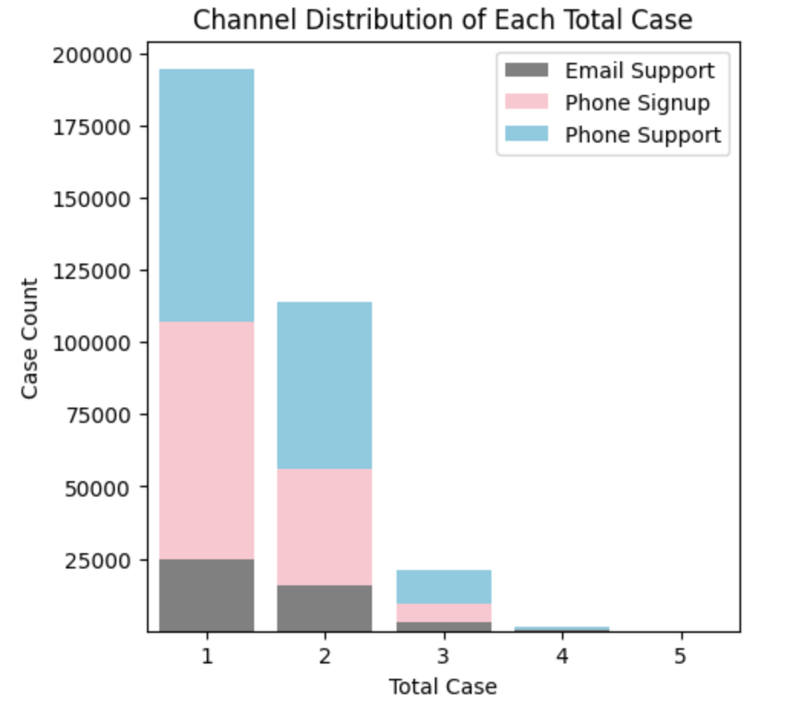
Understanding the different types of Channel-Reason in Customer Cases
There are three types of channel reasons that customers use, with each customer having a minimum of one and a maximum of five cases, and the most commonly used channel reason is phone support.

Slide 13

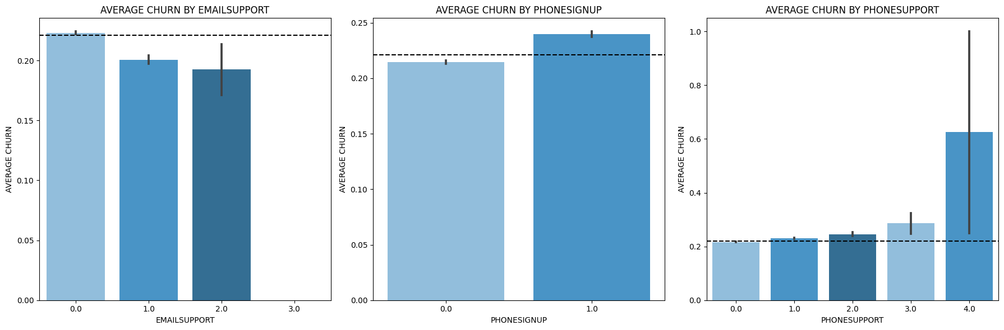
Unveiling Churn Insights via Customer Case Analysis
This clearly indicates that phone support services require more attention, as the higher the number of cases, the higher the churn rate observed.

Slide 14
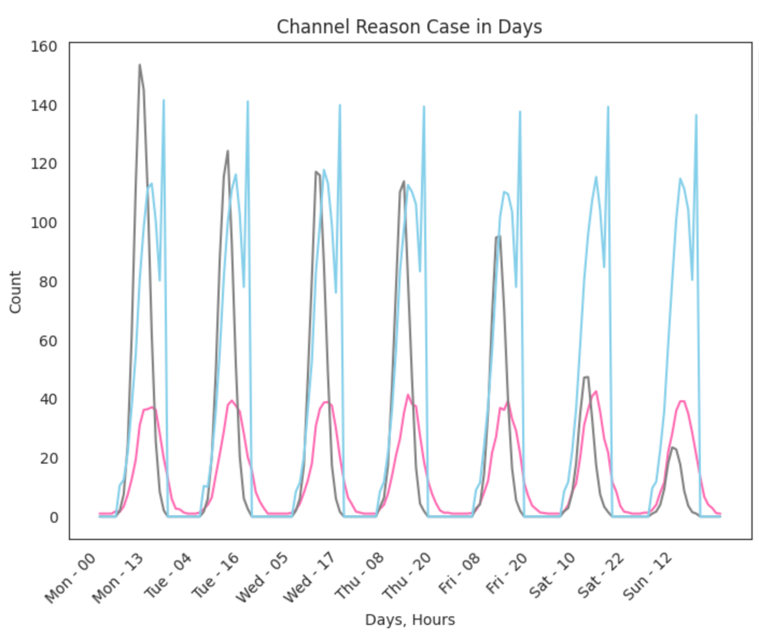
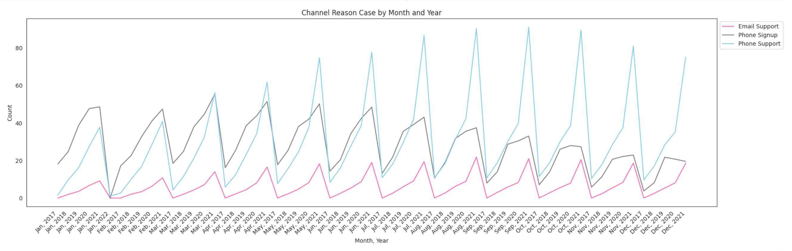
The timing pattern of Customer Cases
The number of cases consistently peaks in the afternoon and evening hours, specifically on the phone support channel.
Customers tend to sign up on weekdays and show an increase in the first half of each year.
Every year, the cases experience a rise during the mid-year period, extending towards the end of the year.
Action
Strengthen the team and service to address these challenges. Ensure extended working hours and adequate training for customer service staff.

Slide 15
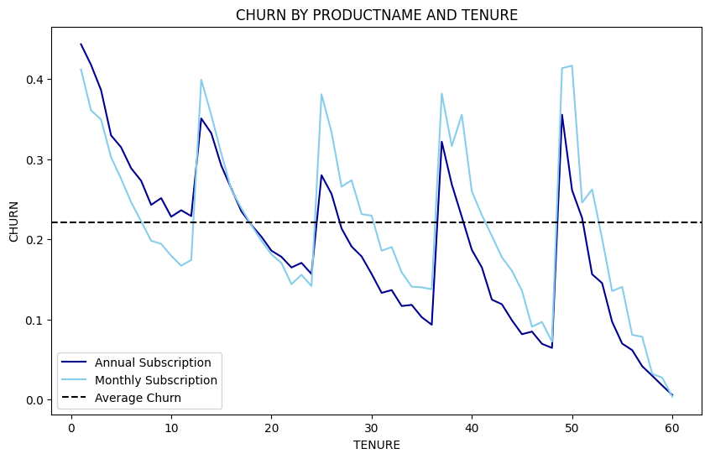
Customer Product and Tenure Role in Churn
Action
Re-evaluate the annual and monthly subscription products. Consider flexible strategies that align more closely with customer preferences. To prevent customers from making single purchases and discontinuing their subscriptions (especially in annual subscription product), consider additional offers, discounts or exclusive benefits that encourage customers to renew their subscriptions.
A significant portion of annual subscription customers make only one purchase and subsequently discontinue their subscription in the subsequent year.

Slide 16


Machine Learning Model

Slide 17

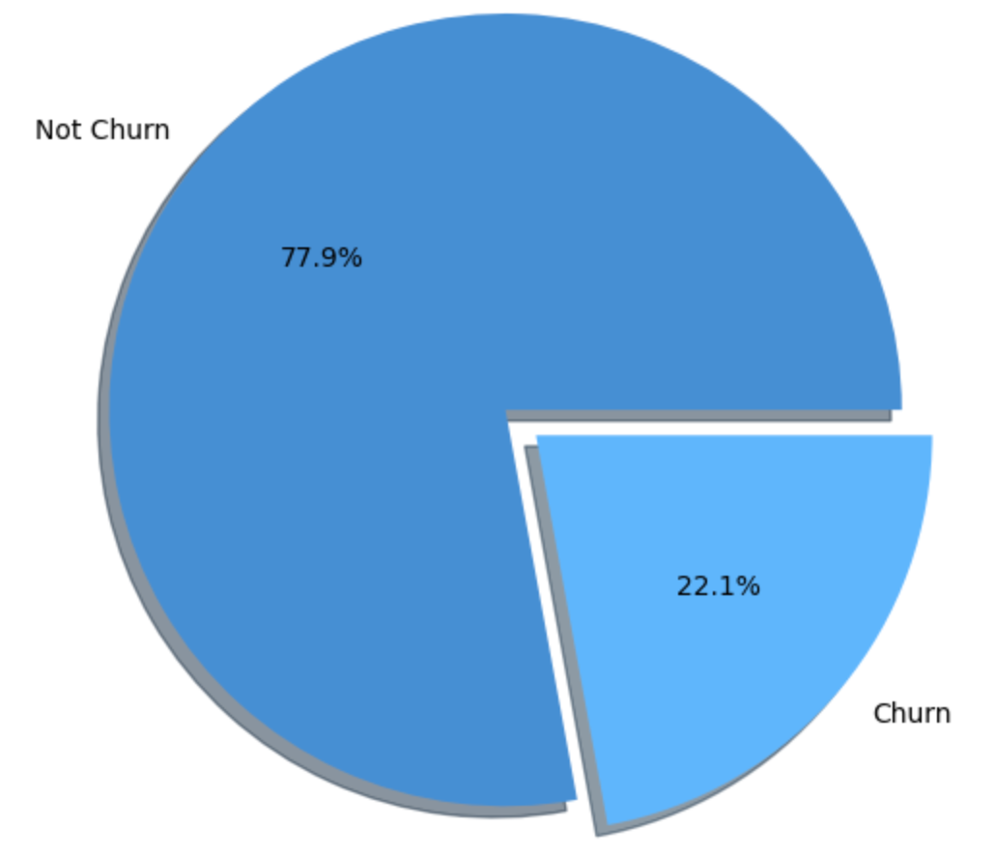
Training and Addressing Imbalanced Data
Percentage of Churn and Not Churn Before Balancing
The training process involved utilizing 80% of the dataset, and to tackle the issue of imbalanced data, the SMOTE oversampling technique was implemented. This method is utilized to increase the minority class synthetically.

Slide 18

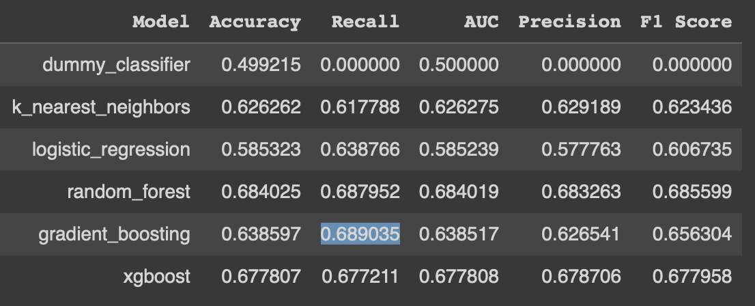
Recall measures correctly identified churn cases out of the total actual churn cases. The goal is to capture as many churn instances as possible, even if non-churn cases are occasionally misclassified. I prioritize reducing missed churns over incorrect non-churn classifications. Simply put, it's better to mistakenly label a non-churning customer as churned than to miss an actual churning customer.
Model Evaluation and Selection: Prioritizing Recall for Effective Churn Prediction

Slide 19
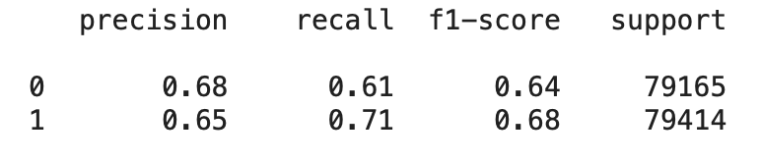
Best Possible Gradient Boosting Classifier Model with Hyperparameter Tuning using GridSearchCV
Recall Score = 0.71
Not Churn
True Label
48160
31005
Churn
23032
56382
The model effectively recognizes 71% of customers who genuinely churn, amounting to 56,382 customers. Additionally, it labels 61% of non-churning customers as churn, aiming to focus on retaining those who might genuinely churn.
Not Churn Churn
Predicted Label

Slide 20

Through the application of SMOTE to our imbalanced dataset, we effectively tackled the problem of uneven labels, leading to an increased count of churn as opposed to non-churn.
Modeling Conclusion
The utilization of HYPERPARAMETER TUNING in the GRADIENT BOOSTING CLASSIFIER modeling has led to the model achieving favorable results, correctly predicting 61% of non-churn instances as churn, and accurately identifying 71% of churn cases.

Slide 21

Profound Impact
Strategic expansion into market segments encompassing diverse customer generations.
Enhancing customer experience through top-notch service to elevate customer satisfaction.
Optimizing product and service quality to meet customer expectations.
Prevent 61% customers to churn and ensure their loyalty.

Slide 22
The battle against churn necessitates steadfast dedication to harness the most recent methodologies and strategies to uphold the stability of customer retention systems.

Slide 23

An ounce of prevention is worth a pound of cure.
– Benjamin Franklin

